Slide 1
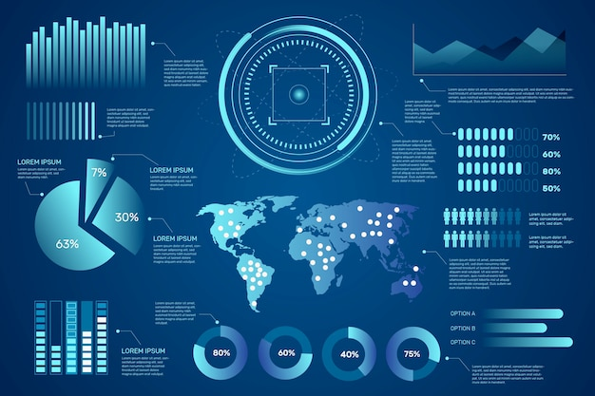

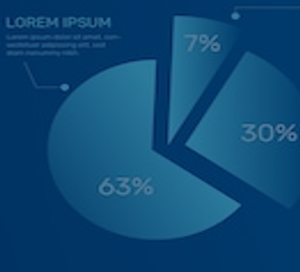
DSA5400
Visual Data Exploration
Module 5: xxxxxx
Michael Dupin, Ph.D.

Slide 2
Course Roadmap & Assignments
Week 1 | Week 2 | Week 3 | Week 4 | Week 5 | Week 6 | Week 7 | Week 8
Course learning objectives Data, information, and knowledge Intro to data visualization | Data as a competitive advantage CRISP framework Human perception and cognition | Data types Intro to ML Grammar of graphics | EDA process ggplot2 (Grammar of graphics continued) | Diagnosis and treatments Special cases: time, space, and clusters | Segmentation R Shiny | Segmentation and profiling Tableau and other dashboards | Course wrap-up Tableau
Introduction | Position Paper #1 | Position Paper #2 | Data Due Diligence Project |  | Segmentation and Profiling Project
Quiz 01 | Quiz 02 | Quiz 03 | Quiz 04 | Quiz 05 | Quiz 06 | Quiz 07 | Quiz 08

Slide 3
Catch up
Position Paper #2 (past) and Due Diligence Project (future)

Slide 4
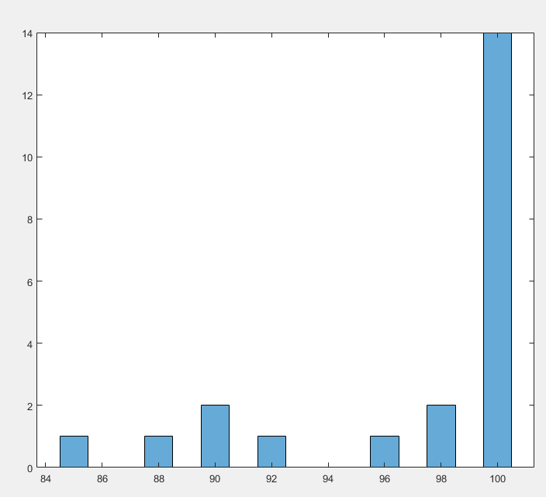


Position Paper #2 Comments – Data Science Students
Position Paper #2
Frequency of Grade
B
B+
A-
A
Grade
“ Given the general explosion of interest in data analytics, perhaps no area of data science has received more attention than predictive modeling. As a result, building predictive models is often among the core responsibilities of data scientists. Unfortunately, data quality can be a huge obstacle to successful predictive modeling projects.
In this position paper, present:
What data-quality-related challenges you have encountered in your experience or in general applications?
How visual (qualitative) and statistical (quantitative) methods were used/could have been used to expose these problems?
What were/could have been the possible remedies? “

Slide 5



Position Paper #2 Comments – Data Science Students
V.S.

Slide 6
Due Diligence Project
Due Diligence Project

Slide 7
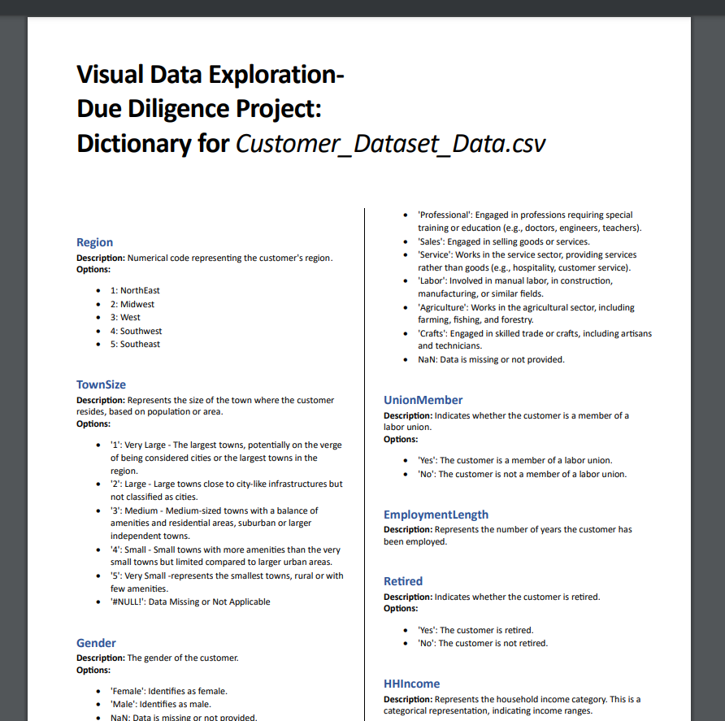
Updated/Corrected Data Dictionary

Slide 8
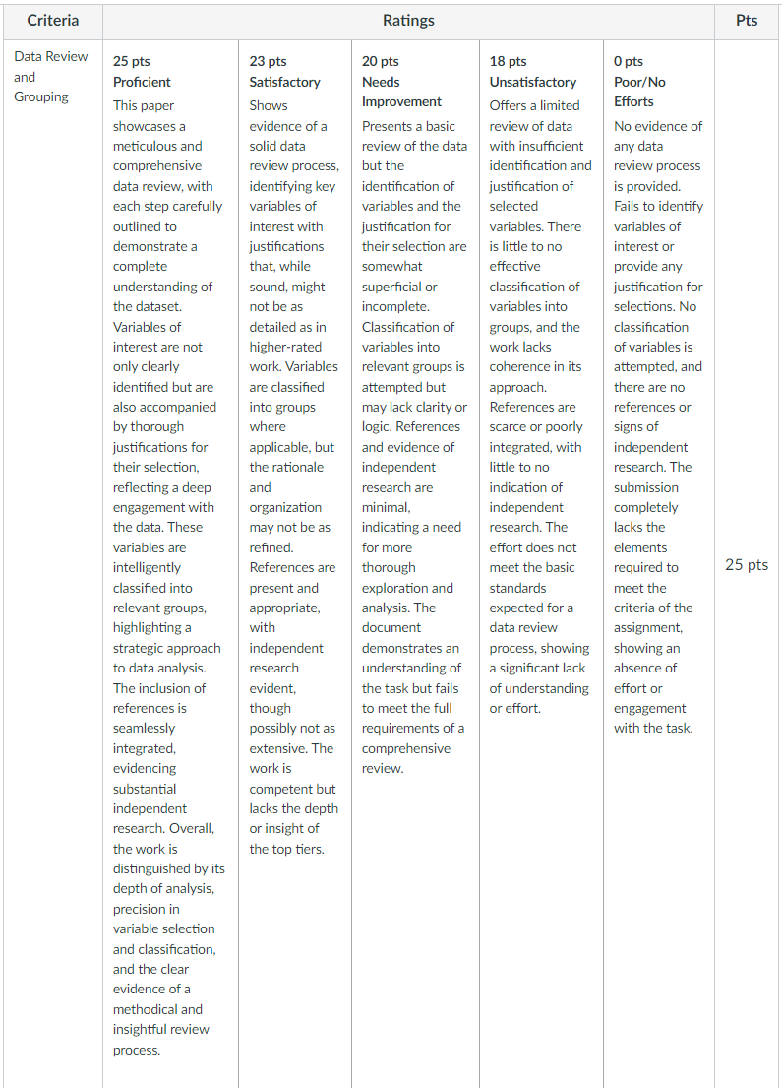
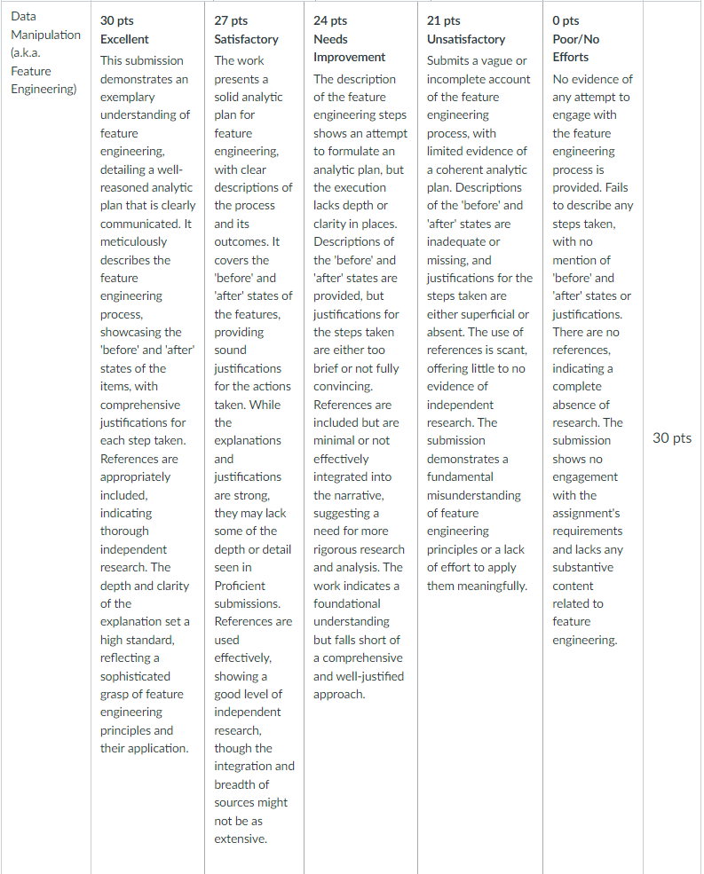
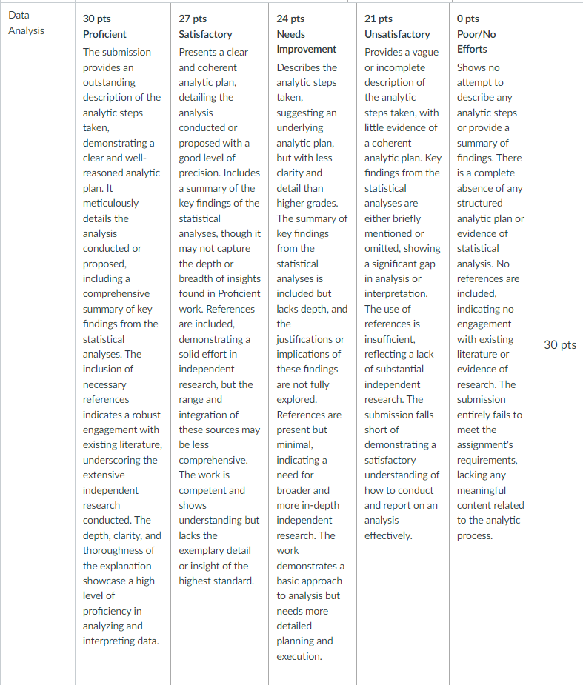
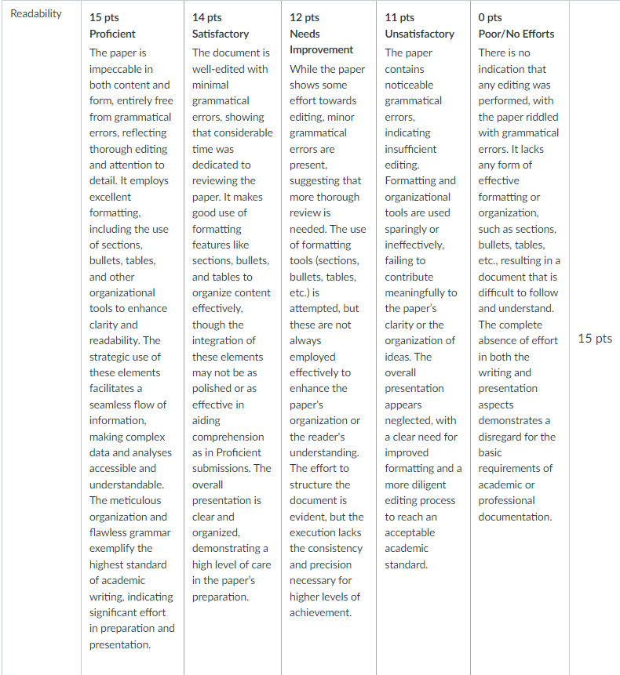
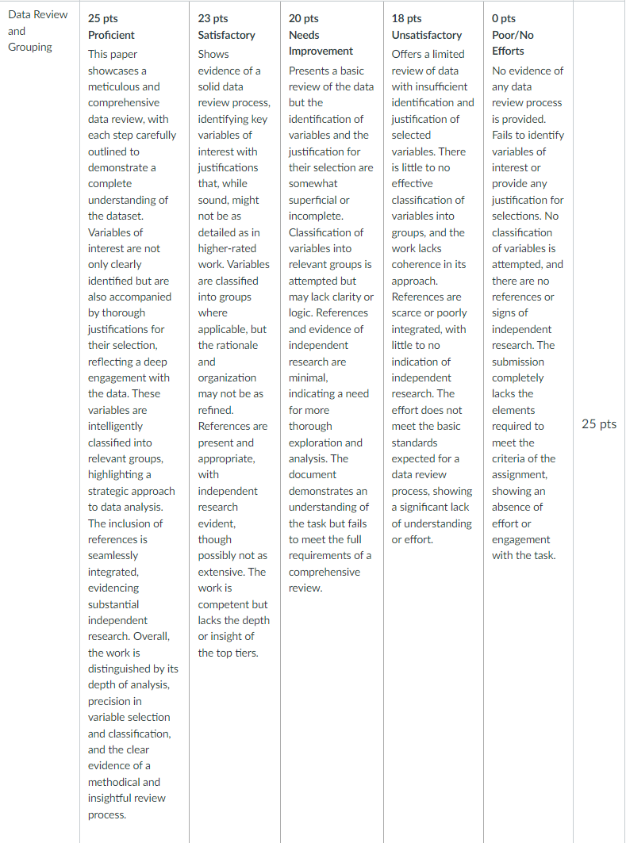
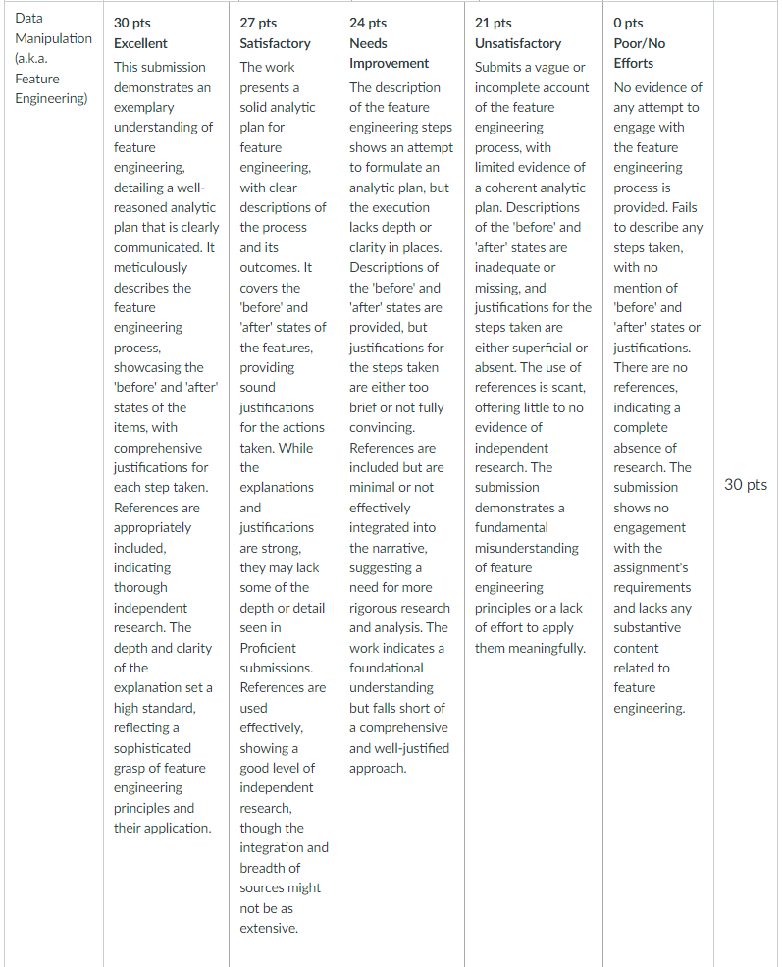
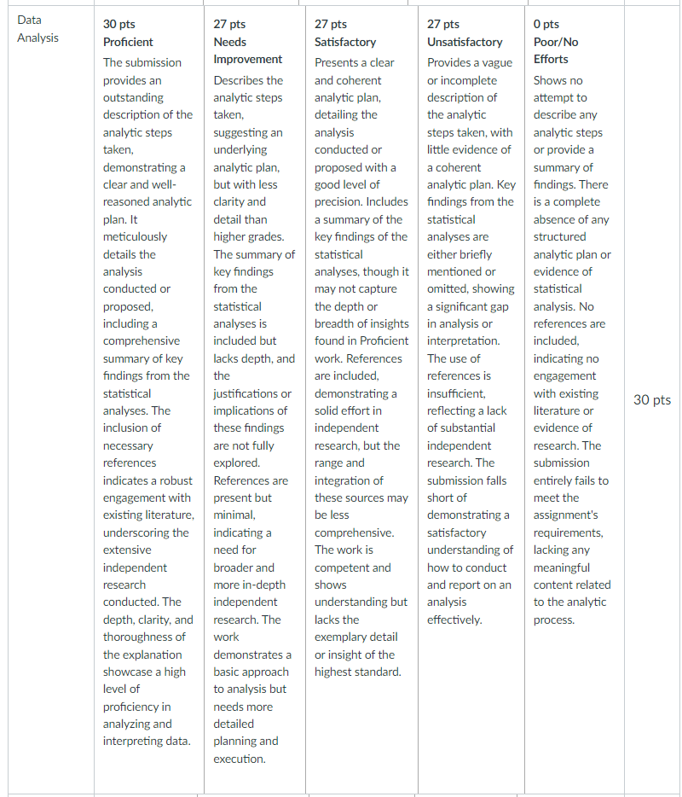
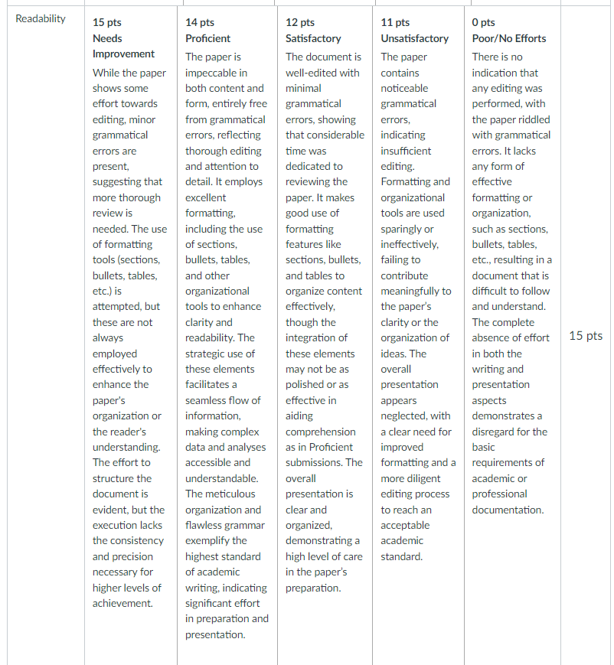
Rubric
Review and Grouping (25%)
Data Manipulation (30%)
Data Analysis (30%)
Readability (15%)

Slide 9
Deliverables
One (PDFed) Word document containing both results and interpretations:
Provide categories for all variables (meaning, objective, type... all are possible)
Create at least 10 features/columns and state why you created them (at least 10). These can be cleaned, derived, or normalized columns, among other treatments.
Provide a several examples of qualitative or graphical analysis on features
Single variable plots (chosen by correct type of data - categorical, ordinal, real-values)
Perform at least 5 two-column analyses (scatterplots, regression fits)
A brief (1-2 pages) summary of all data due diligence and feature engineering changes, including a brief (1-2 sentences) explanation rationalizing each action.
One curated Excel file that contains:
The original columns
New columns for new features
If you do any analysis in Excel (visualization, calculations, tables, etc) , use a different tab called "Analyses" to keep the data tab clean
No need to submit your R, Tableau (prep or desktop), Python, etc codes.
Questions on the assignment so far?

Slide 10


Exploratory Data Analysis (EDA) Review
More Examples with R and Tableau
week-5-eda-plots
Module 5 - Tableau Exhibits EDA

Slide 11
Diagnostics and Treatments
Getting into the Metadata
Prep: Diagnostic - Customer Data

Slide 12
Meta Data Analysis – Sample Outputs

Slide 13
Meta Data Analysis – Sample Categorical Variables Outputs
Region | Frequency | Percent | Cumulative Frequency | Cumulative Percent
1 | 1009 | 20.18 | 1009 | 20.18
2 | 995 | 19.9 | 2004 | 40.08
3 | 1003 | 20.06 | 3007 | 60.14
4 | 966 | 19.32 | 3973 | 79.46
5 | 1027 | 20.54 | 5000 | 100
UnionMember | Frequency | Percent | Cumulative Frequency | Cumulative Percent
No | 4244 | 84.88 | 4244 | 84.88
Yes | 756 | 15.12 | 5000 | 100
LoanDefault | Frequency | Percent | Cumulative Frequency | Cumulative Percent
No | 3829 | 76.58 | 3829 | 76.58
Yes | 1171 | 23.42 | 5000 | 100
JobCategory | Frequency | Percent | Cumulative Frequency | Cumulative Percent
 | 15 | 0.3 | 15 | 0.3
Agriculture | 212 | 4.24 | 227 | 4.54
Crafts | 452 | 9.04 | 679 | 13.58
Labor | 686 | 13.72 | 1365 | 27.3
Professional | 1380 | 27.6 | 2745 | 54.9
Sales | 1635 | 32.7 | 4380 | 87.6
Service | 620 | 12.4 | 5000 | 100
CarOwnership | Frequency | Percent | Cumulative Frequency | Cumulative Percent
-1 | 497 | 9.94 | 497 | 9.94
Lease | 799 | 15.98 | 1296 | 25.92
Own | 3704 | 74.08 | 5000 | 100
CarBrand | Frequency | Percent | Cumulative Frequency | Cumulative Percent
-1 | 497 | 9.94 | 497 | 9.94
Domestic | 2287 | 45.74 | 2784 | 55.68
Foreign | 2216 | 44.32 | 5000 | 100
CreditCard | Frequency | Percent | Cumulative Frequency | Cumulative Percent
AMEX | 986 | 19.72 | 986 | 19.72
Disc | 1344 | 26.88 | 2330 | 46.6
Mast | 1200 | 24 | 3530 | 70.6
Othe | 223 | 4.46 | 3753 | 75.06
Visa | 1247 | 24.94 | 5000 | 100
EquipmentRental | Frequency | Percent | Cumulative Frequency | Cumulative Percent
No | 3296 | 65.92 | 3296 | 65.92
Yes | 1704 | 34.08 | 5000 | 100
EBilling | Frequency | Percent | Cumulative Frequency | Cumulative Percent
No | 3257 | 65.14 | 3257 | 65.14
Yes | 1743 | 34.86 | 5000 | 100
Multiline | Frequency | Percent | Cumulative Frequency | Cumulative Percent
No | 2558 | 51.16 | 2558 | 51.16
Yes | 2442 | 48.84 | 5000 | 100
OwnsMobileDevice | Frequency | Percent | Cumulative Frequency | Cumulative Percent
No | 2604 | 52.08 | 2604 | 52.08
Yes | 2396 | 47.92 | 5000 | 100

Slide 14
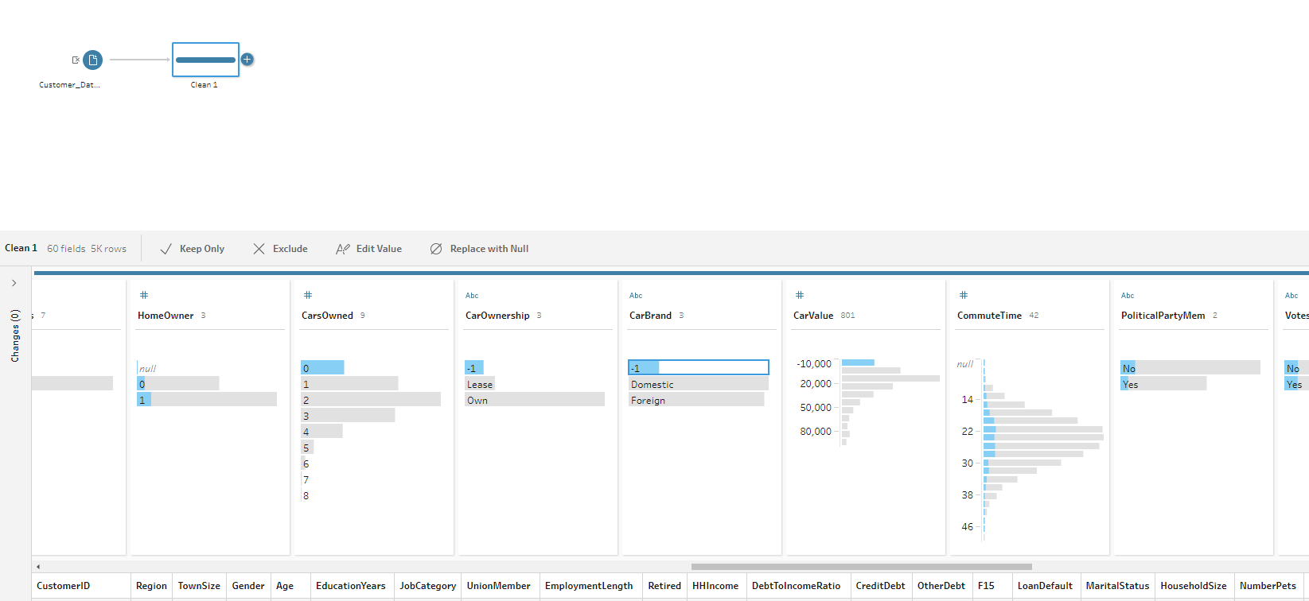
Meta Data Analysis – Sample Categorical Variables Outputs

Slide 15
Meta Data Analysis – Initial Variable Exclusions
A list of variables such as the following are quickly dropped after meta data analysis:
Variables with more than 95% or 99% missing values
Variables with constant values (all records have the same value)
Variables with sparse distribution (e.g., 99% of the records have the same value)
Variables that cannot be used as model predictors such as IDs, match key fields and post-reference date variables can also be dropped
Univariate statistics are reviewed to provide more insights about the variable distributions and to take note of variables with outliers to be targeted for variable transformation and recode
But some variables with high% of missing can be useful for targeting in marketing campaigns although they are not viable for modeling, e.g., life events such as change of marital status, new baby

Slide 16
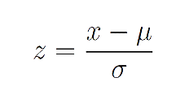
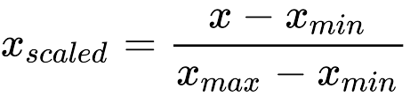
Treatments / Transformations
Common problems
Data cleansing
Remove or isolate missing values
Remove or isolate outliers
Transform or correct values when necessary
Outliers and anomalies
Missing values
Poor quality data
Data normalization
Z-transform
Impute outliers or missing values
Average values
Estimates (with model or not)
Regression
Other Model-Based Methods
Normalization - min/max scaling
Each have the possibility to match or distort the dataset being considered.
Log (or x^-N) Transform
x scaled = log (x) , or log (x+1) if x can be zero
x scaled = x^{-1/N} , where N is 0.5 … 5 typically
*** In general, you always want to keep both the original data columns and transformations available for analysis ***

Slide 17
Special Cases: Time, Space, and Clustering
Useful to know
timeseries-example
Caribou_time_series

Slide 18
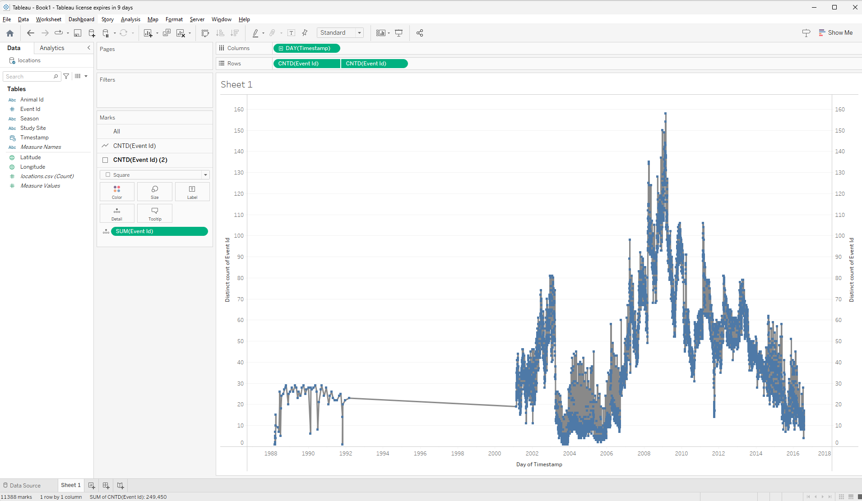
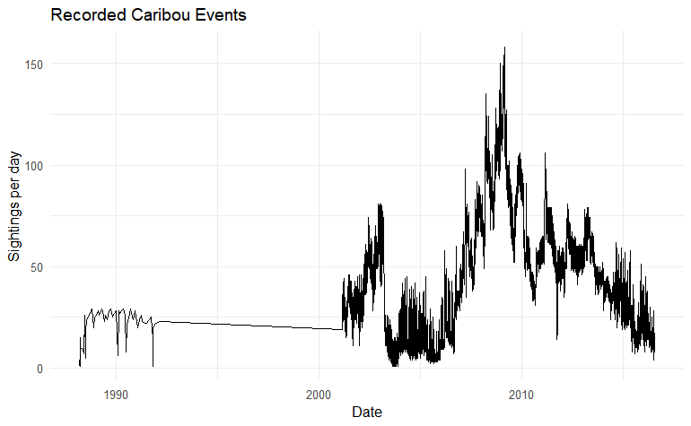
Plots with Time (Scatter and Line Plots)
Thoughts to consider:
Make sure your variables are the right type
Set useful tick intervals
Be careful with gaps in data

Slide 19
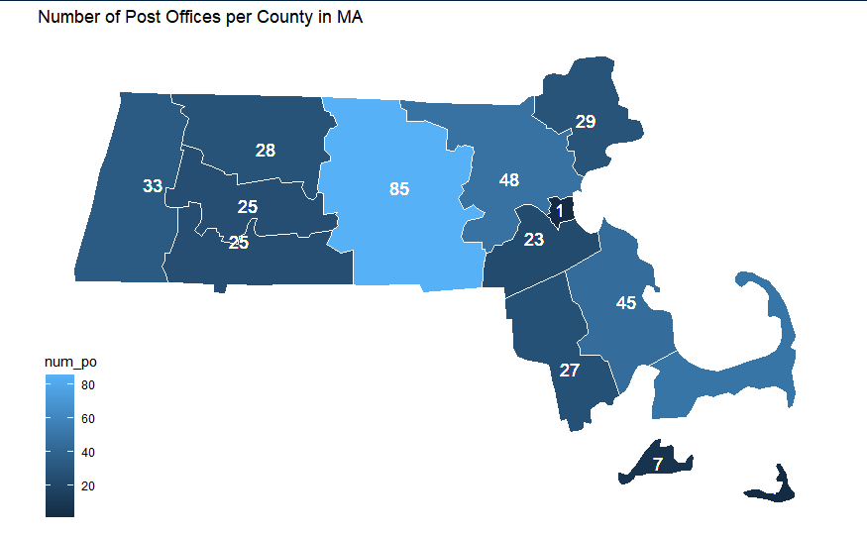
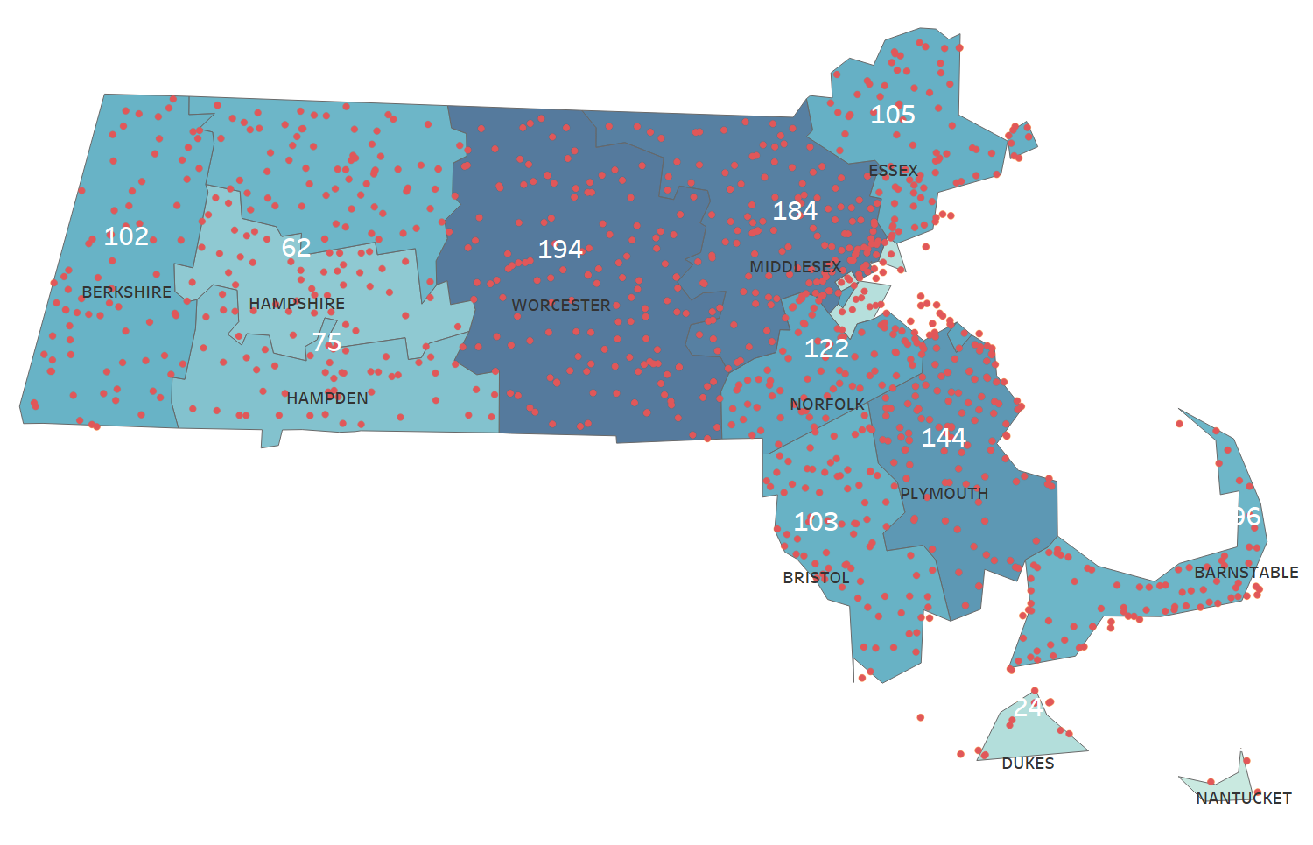
Geospatial plots
Any map is a combination of lines and points
often collected in shapefiles
Any visualization package (R, Tableau, etc) has libraries for common boundaries.
Using geom_polygon, you can treat them like any object in a plot.
maps-example
Maps

Slide 20
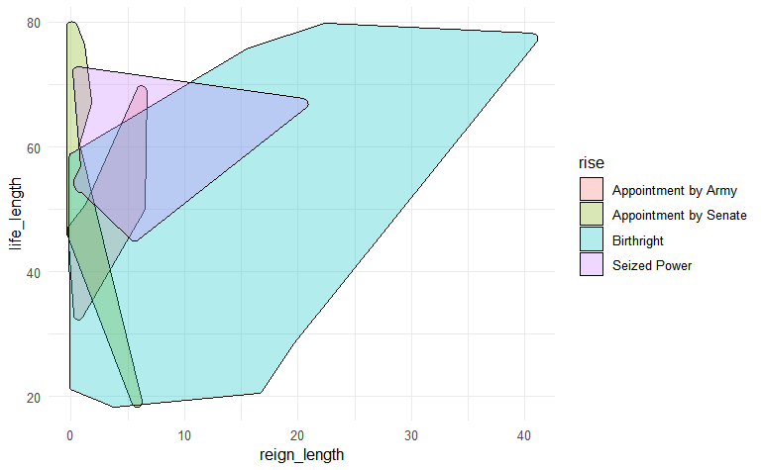
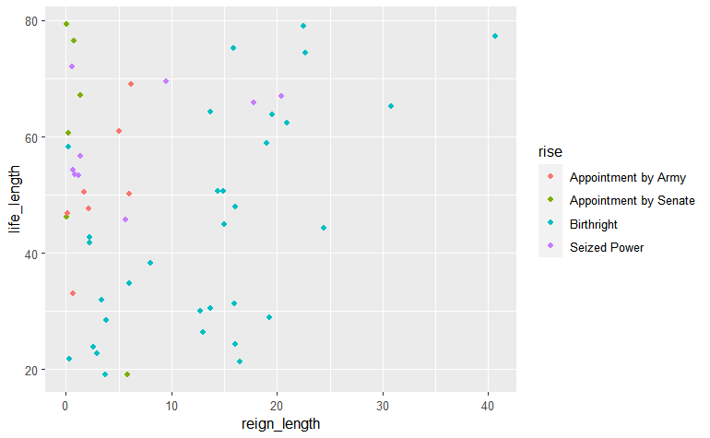
Clusters
When are trying to visualize clusters by two or more continuous variables, pictures of the shapes can be very powerful.
ggalt and ggforce* can be used to add shapes around data points.
* These are very useful ggplot extensions!

Slide 21
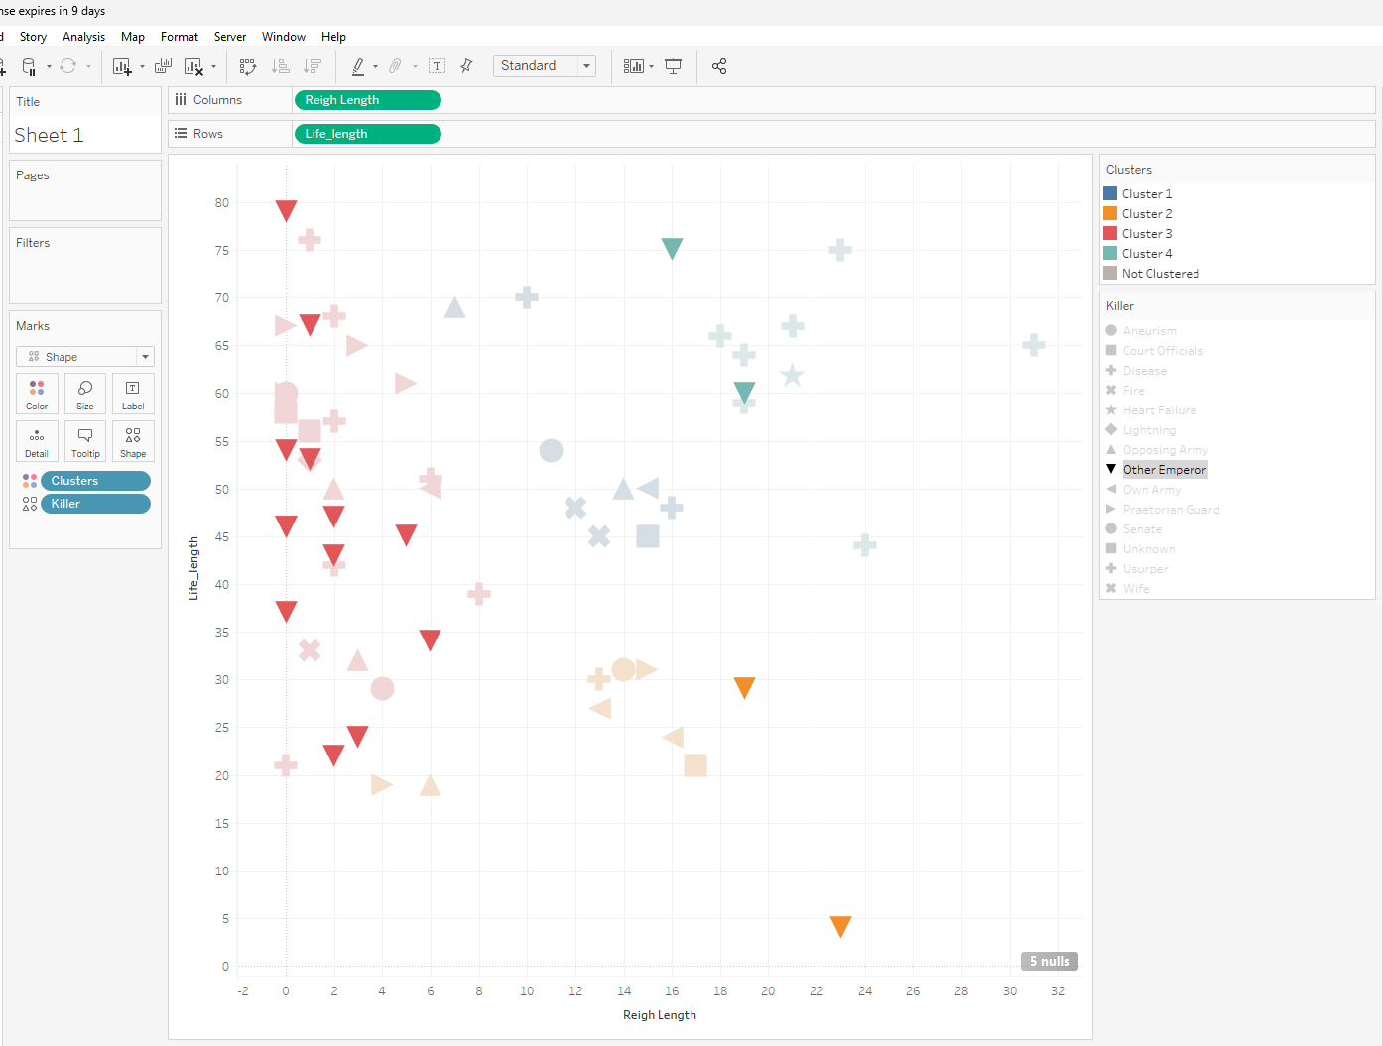
Clusters
Tableau is AWESOME at QUICK and EFFICIENT filtering for EDA:

Slide 22
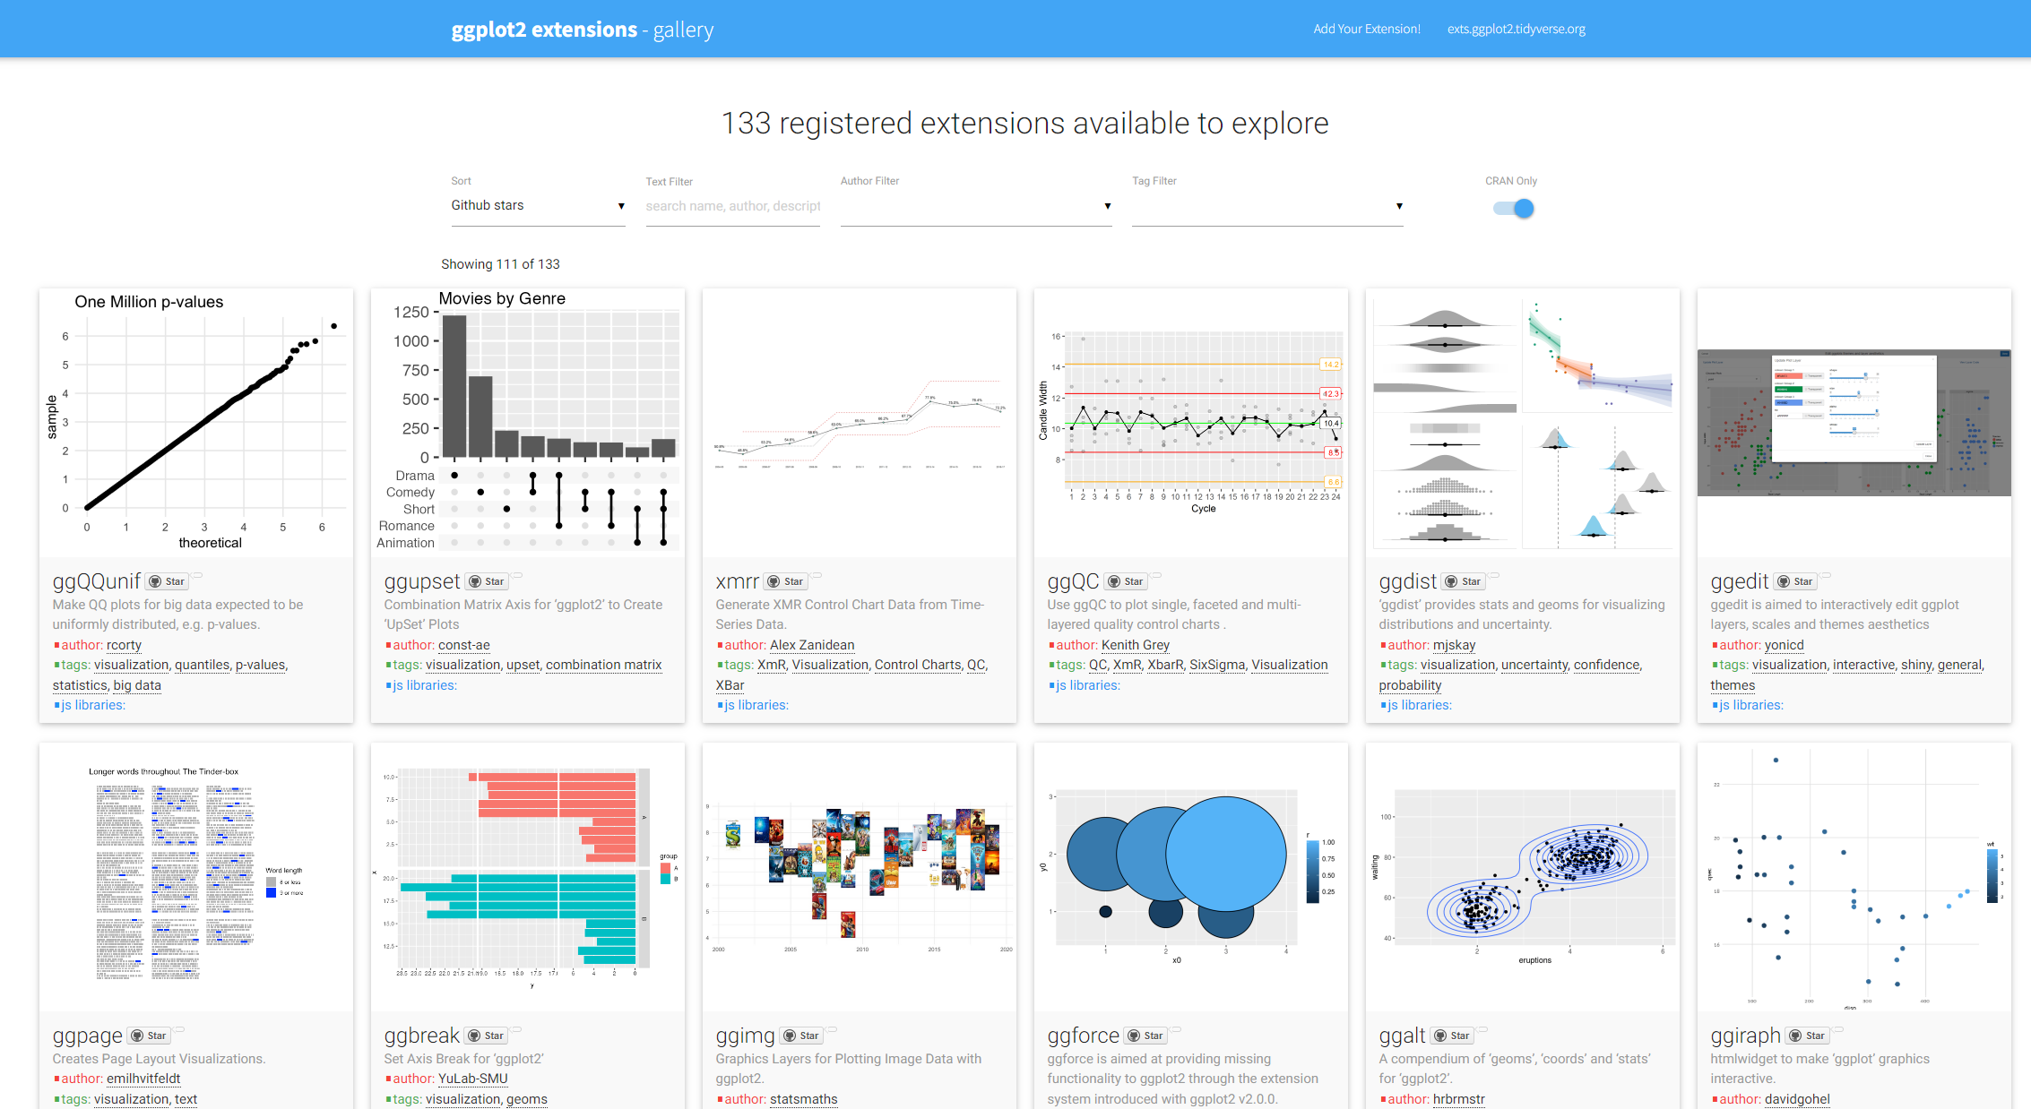
ggplot Extensions
https://exts.ggplot2.tidyverse.org/gallery/

